Slide 1
The art of giving Feedback
Dr. Ramesh Mehay, Bradford VTS

Slide 2
OBJECTIVES
The purpose of feedback
The positive spirit of feedback
How to do it
What to do when it goes wrong
Some ground rules
Formal methods of feedback
The emotional bank balance concept

Slide 3
1. THE PURPOSE OF GIVING FEEDBACK

Slide 4
How can we expect people to change and develop if they don’t know what they need to change?
Unless they get feedback, how do they know what they do well so they can continue doing it?

Slide 5
Feedback is:
information
about performance or behaviour
that leads to action to affirm or develop that performance or behaviour.
Notes:
The first key word in this definition is information…ie hard facts, concrete data, observable examples of performance and behaviour etc. ………….. NOT personal hunches, NOT assumptions!
Second key point is the information is about performance or behaviour (ie what the person does and how they do it)…….NOT ABOUT WHO THEY ARE.
Third key point is that it has a very specific intention, that is, to lead to action. If this does not happen, then there is no point in giving it.
Fourth key point is that feedback is intended to affirm or develop performance or behaviour. This means that before delivering feedback, the deliverer must be clear as to the outcome they wish to see. If this is not clear to the deliverer, what hope has the recipient got??

Slide 6
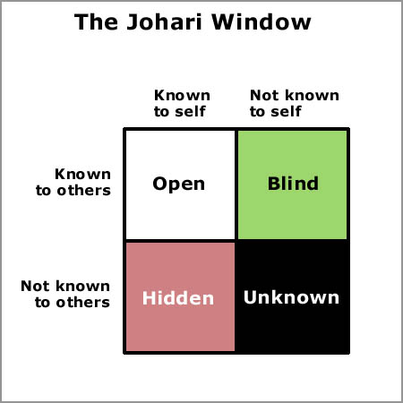
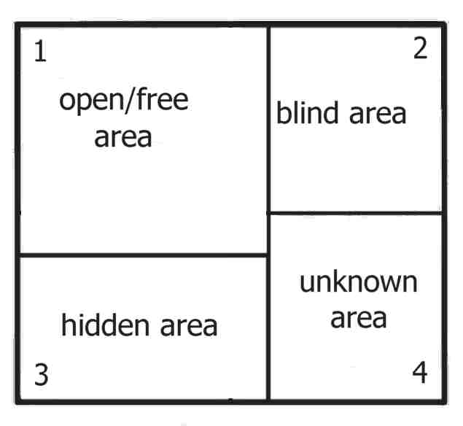
Why do we give feedback

Slide 7
Why talk about feedback?
Giving effective and constructive criticism is one of the most common concerns of educational supervisors
Many consultants and GP trainers feel ill prepared in giving feedback on performance
Yet:
  The most powerful single modification that enhances “achievement” is feedback.
  It permeates through the whole of GP training.
  And it features in ALL aspects of our lives
  It’s a life skill (happy families)

Slide 8
2. The positivity of feedback

Slide 9
The positivity of feedback
Improving performance
Bringing out the best
Motivating
Raising self awareness (cog dis)
Developing insight
Enabling change
Feeling empowered

Slide 10
THE POSITIVITY OF FEEDBACK
Most people really want to know how they are doing. They want to know if other people like what they’re doing.
They also want to know if something could be done more effectively or if boundaries are being overstepped.

Slide 11
3. THE ART OF GIVING FEEDBACK

Slide 12
A feedback experience
Think back to a situation when you received feedback.
What happened?
How did you FEEL?
What did you THINK?
  So was it positive or negative?
  What was it about the content that made it good or bad?
  What was it about the process that made it good or bad?
  Was there anything about YOU that made it good or bad?
  Did you gain a new insight? If not, why not?
  Did you reflect, learn and plan? If not, why not?
  Did anything change? If not, why not? What might have helped it change?

Slide 13
Feedback is NOT ABOUT:
Praise or blame, approval or disapproval.
How well you did in a test or exercise.
Telling a person what to do.
Making premature judgements about a person.
CRITICISM is about dumping anger, telling people how they should be.
FEEDBACK is about real life and your normal day to day work/activities. It’s designed to reinforce or change behaviour.
Notes:
Feedback is not derived from tests, exercises or simulations. The activity being assessed is your normal work. You cannot get closer to real life than real life itself.

Slide 14
YOUR STARTING POINT
Positive
Mutual respect
Genuineness
Giving time
Enthusiasm
“Unconditional positive regard”
Negative
Humiliation
Commenting on personality
No time for discussion
Lack of interest
Given too late

Slide 15
before you give feedback
Always ask yourself:
What is my intention behind giving this person feedback?
How am I feeling about giving it?
How is the other person feeling
BOTH PEOPLE (GIVER & RECIEVER) SHOULD BE IN A GOOD ENOUGH STATE
Notes:
Always ask yourself:
What is my intention behind giving this person feedback?
How am I feeling about giving it?
How is the other person feeling; if they have had a stressful day, might be best left for another occasion. It is important they are in the right frame of mind to accept it
BOTH PEOPLE SHOULD FEEL CALM

Slide 16
WHEN YOU GIVE FEEDBACK
TIMELY - close to the event as possible, right time, right place
SELECTIVE – 2/3 key issues not 22!
BALANCED - between good and bad
SUGGESTIONS - rather than PRESCRIPTIONS
DESCRIPTIVE - not judgemental
SPECIFIC - or focussed
- Avoid personal comments
- Avoid Mixed Messages
- Avoid diffusion
DIRECTED - towards behaviour that can be changed (not personality)
(Brown & Leigh’s Feedback Rules, 1996)
Notes:
Descriptive – not judgemental
Specific – not generalised
About behaviour – which can be changed – not personality – which can’t
Sensitive to the needs of the recipient
Selective and prioritised
Timely – as close to the event as feasible

Slide 17
Micro-skills
Active Listening
Response to Cues
Open Questions
Challenge
Summarising
Facilitating Reflection
Enabling insight – creating empowering cognitive dissonance.
Notes:
Active Listening- encouraging the participants contribution
Response to Cues- to respond appropriately to important, significant (in terms of what emerges afterwards) cues
Open Questions- (opposite of closed), “tell me more, describe the situation…”
Challenge- who, what, where, when, how questions.
Summarising- “So if I understand you…”
Facilitating Reflection- The learning cycle- To do, think, learn and plan…
Enabling insight – creating empowering cognitive dissonance.

Slide 18
EXAMPLE s – can you improve on these?
"I think your selfish in that you don’t listen to anyone else".
"I notice that you don’t look at people when they are talking to you".
‘I really don’t like your face – it’s so miserable looking at times’
‘It would help me if you smiled more or looked at me when you speak’
‘John, you always look as if you have just got out of bed but your work is good on the whole’
‘John, I would like you to take more care with your appearance in order to make a better impression’
‘Richard - you are not Read coding very well. You have to improve.’
‘Richard, I’ve noticed that sometimes you’re not Read coding a diagnosis. Can we talk about it & work out some plans to improve?’
Notes:
Both these comments can apply to the same situation, but
the first describes what is happening, whereas the second is judgmental.
The first gives information which the other person would find difficult to dispute, but relatively easy to take action on.
The second is more likely to provoke a defensive reaction, with little chance of any resultant improvement.

Slide 19
WHAT IS BEHAVIOUR?
Exercise in pairs
5 minutes

Slide 20
It’s about the good STUFF too
Positive reinforcement increases the likelihood that a behaviour will be repeated
Motivation Increases when success is expected
Motivation decreases when a goal is perceived as impossible
But unfortunately, often only the negative aspects are commented on and/or remembered.

Slide 21
4. DOING FEEDBACK BADLY

Slide 22
Bad things to do
Deny the other persons feelings
Be vague
Accuse
Take for granted the person has understood
Bring in third parties
Be negative
Be destructive
Be judgemental
Bring up behaviours that the person cannot help
Be overly impressed
Be aggressive

Slide 23
There are 4 undesirable ways a trainee may respond to feedback
BUT there 5 ways a trainer might respond to this in a counter-productive way
Whilst you might not be able to control the trainee’s initial response, you can control the responses after that
Notes:
But, in order to do this
You have to recognise the unfavourable cues a trainee is giving off
You need to be aware of counter-productive responses
So that you can respond in a way which is likely to be productive
(productive = trainee accepts the feedback and wants to do something about it (change))

Slide 24
the undesirable ways a trainee & TRAINER can respond
TRAINEE – 4 ways
Denial
Rationalise
Anger
Blame
TRAINER – 5 ways
Colluding
Obligation
Moral high ground
Burying and fudging
Minimising
Jennifer King, Psychologist, BMJ 1999
Notes:
The person receiving the feedback can react with:
Anger – ‘I’ve had enough of this’
Denial – this reaction often accompanies the initial shock of feedback ‘I cant see any problem with that’
Blame – ‘It’s not my fault. What can you expect when the patient won’t listen?
Rationalisation – finding excuses to try and justify their behaviour ‘I’ve had a particularly bad week’ ‘Doesn’t everyone do this?’
Acceptance
Renewed Action
Colluding
"You're probably right, perhaps I am overreacting"
Obligation
"I'm duty-bound to tell you this"
Moral high ground
"It's for your own good“
Burying and fudging
Taking a long time to get to the point and covering many irrelevancies.
Minimising
"Don't worry, it's not such a big deal. Everyone does it at some time"

Slide 25
VIDEO CLIPS DEMONSTRATING THESE
http://vimeo.com/album/1537045

Slide 26
Better ways of responding
Name and explore the resistance
Keep the focus positive
Try to convince the trainee to own one part of the problem
Negotiate
Allow time out
Keep the responsibility where it belongs
Notes:
Name and explore the resistance to understand it
"You seem bothered by this. Help me understand why"
"Help me to understand more about why you feel so angry"
Keep the focus positive
"Let's recap your strengths and see if we can build on any of these to help address this problem"
Try to convince the trainee to own one part of the problem
"So you would accept that on that occasion you did lose your temper"
Negotiate
"I can help you with this issue, but first I need you to commit to ..."
Allow time out
"Do you need some time to think about this?"
Keep the responsibility where it belongs
"What will you do to address this?"

Slide 27
5. Methods of giving feedback

Slide 28
Exercise - methods
Exploring Pendleton
Exploring SET-GO
Exploring ALOBA

Slide 29
Pendleton
The trainee comments on strengths
The trainer reinforces and adds
The trainee comments on weaknesses
The trainer reinforces and may add
With evidence and suggestions

Slide 30
SET - GO
What did you See?
What Else?
What do you Think, John?
What Goal would you like to achieve?
Any Offers on how we should get there?

Slide 31
ALOBA
Can go straight to the “hot”
issue ..it is agenda led!

Slide 32
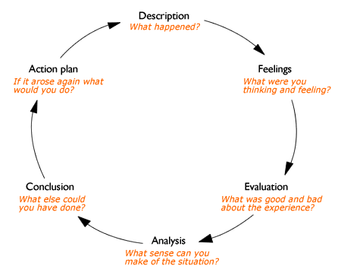
Gibbs
Neat tool for tackling the emotionally charged “case discussions” or “consultations”.

Slide 33
ABCDE of Feedback
Approach
Sensitive to the person and their learning agenda
Balance
Of positives and negatives as per Pendleton.
Credits to exceed Withdrawals to avoid an “Emotional Overdraft”
Change
To facilitate Change by Active Listening, responding to Cues to and providing Challenge.
To identify their problem and, through skill rehearsal, to work on their solution.
As per SET GO
Description
Feedback based on fact and not on opinion throughout.
Exact
Feedback focusing on specific areas throughout.

Slide 34
6. FINAL COMMENTS

Slide 35
TALKING TO YOUR TRAINEE ABOUT FEEDBACK
- getting onto the same wavelength
Notes:
Of what feedback is about
Good intentions
To improve and make them better.
Done at induction.

Slide 36
PROMOTE A SHARED UNDERSTANDING
Read or listen carefully
Understand – seek clarification, examples, suggestions
Give it time to sink in - get it into perspective
Identify, Action Plan
Try not to feel devastated - by small criticisms
Try not to be defensive – by making excuses; be receptive.
Remember that it is being given with good intention.
Remember that it may not have been easy to give.
Notes:
Read or listen to comments carefully and ensure you understand what is written/said. If not, ask. Ask for clarification, examples and alternatives. Keep notes of what is said to you.
Give it time to sink in and get into perspective
Try to keep feedback sheets/information together, so you can see common themes.
Build on your strengths
Address areas for improvement. Identify what you need to do to reach the higher standard. Produce an Action Plan based on feedback information and on your views of what is important to improve eg: areas to improve, actions to take, sources of help, when to tackle? (date)
Try not to
feel devastated by small criticisms and try not to be defensive and make excuses
Listen carefully to what is being said
People should be receptive to feedback and see it as helpful.
Don’t reject it!
Accept positive feedback…don’t reject it!
Accept negative feedback...don’t reject it!
Avoid arguing or being defensive.
Ask questions to clarify fully and seek examples is useful.
Acknowledge the giver of feedback and show his or her appreciation. The feedback may not have been easy to give.
Involve mutual good will
receiver should feel that the giver isn’t their enemy
giver needs to want to help receiver develop

Slide 37
Emotional Bank Balance
Credits must be in place before withdrawals are made
Credits must exceed withdrawals
To avoid an emotional overdraft that is ultimately unsustainable
The balance of support and challenge

Slide 38
FEEDBACK AS A GIFT
Is this gift useful to me now?
How was it wrapped?
Can I find a use for it (if not immediately obvious)?
If it’s not a useful gift, might it be useful later?
Would a similar gift be useful for others?
How would I feel if I didn’t get a gift?
How would I feel if other people got gifts all the time and I got none?
Am I careful how I choose and wrap my gifts?
When I give a gift, am I being clear it really is for them?

Slide 39
Feedback is a life skill
  The more you do it, the better you become.
  Improves all parts of your life.
  There are better ways to provide feedback, but there is no ‘wrong way’.
  Just do it!

